Slide 1

WEB 2.0 (CSE 2056)
Department of Computer Science and Engineering
School of Engineering,
PRESIDENCY UNIVERSITY

Slide 2
MODULE 2
Data interchange formats: XML, XML basics; XML Schema; Types, Sample program for XML, Overview of JQuery, JQuery example, Overview Angular JS

Slide 3
eXtensible Markup Language (XML)
Outline of Presentation
Introduction
Comparison between XML and HTML
XML Syntax
XML Queries and Mediators
Challenges
Summary

Slide 4
What is XML?
eXtensible Markup Language
Markup language for documents containing structured information
Defined by four specifications:
XML, the Extensible Markup Language
XLL, the Extensible Linking Language
XSL, the Extensible Style Language
XUA, the XML User Agent

Slide 5
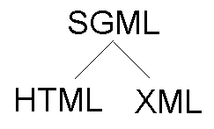
XML….
Based on Standard Generalized Markup Language (SGML)
Version 1.0 introduced by World Wide Web Consortium (W3C) in 1998
Bridge for data exchange on
the Web

Slide 6
Comparisons
XML
Extensible set of tags
Content orientated
Standard Data infrastructure
Allows multiple output forms
HTML
Fixed set of tags
Presentation oriented
No data validation capabilities
Single presentation

Slide 7

Authoring XML Elements
An XML element is made up of a start tag, an end tag, and data in between.
Example:
<director> Matthew Dunn </director>
Example of another element with the same value:
<actor> Matthew Dunn </actor>
XML tags are case-sensitive:
<CITY> <City> <city>
XML can abbreviate empty elements, for example:
<married> </married> can be abbreviated to
<married/>

Slide 8
Authoring XML Elements (cont’d)
An attribute is a name-value pair separated by an equal sign (=).
Example:
<City ZIP=“94608”> Emeryville </City>
Attributes are used to attach additional, secondary information to an element.

Slide 9
Authoring XML Documents
A basic XML document is an XML element that can, but might not, include nested XML elements.
Example:
<books>
<book isbn=“123”>
<title> Second Chance </title>
<author> Matthew Dunn </author>
</book>
</books>

Slide 10
XML Data Model: Example
<BOOKS>
<book id=“123” loc=“library”>
<author>Hull</author>
<title>California</title>
<year> 1995 </year>
</book>
<article id=“555” ref=“123”>
<author>Su</author>
<title> Purdue</title>
</article>
</BOOKS>
BOOKS
book
loc=“library”
article
ref
123
555
author
year
author
title
title
Hull
1995
Su
Purdue
California

Slide 11
Authoring XML Documents (cont’d)
Authoring guidelines:
All elements must have an end tag.
All elements must be cleanly nested (overlapping elements are not allowed).
All attribute values must be enclosed in quotation marks.
Each document must have a unique first element, the root node.

Slide 12
Authoring XML Data Islands
A data island is an XML document that exists within an HTML page.
The <XML> element marks the beginning of the data island, and its ID attribute provides a name that you can use to reference the data island.

Slide 13
Authoring XML Data Islands (cont’d)
Example:
<XML ID=“XMLID”>
<customer>
<name> Mark Hanson </name>
<custID> 29085 </custID>
</customer>
</XML>

Slide 14
Document Type Definitions (DTD)
An XML document may have an optional DTD.
DTD serves as grammar for the underlying XML document, and it is part of XML language.
DTDs are somewhat unsatisfactory, but no consensus exists so far beyond the basic DTDs.
DTD has the form:
<!DOCTYPE name [markupdeclaration]>

Slide 15
DTD (cont’d)
Consider an XML document:
<db><person><name>Alan</name>
<age>42</age>
<email>agb@usa.net </email>
</person>
<person>………</person>
……….
</db>

Slide 16
DTD (cont’d)
DTD for it might be:
<!DOCTYPE db [
<!ELEMENT db (person*)>
<!ELEMENT person (name, age, email)>
<!ELEMENT name (#PCDATA)>
<!ELEMENT age (#PCDATA)>
<!ELEMENT email (#PCDATA)>
]>

Slide 17
DTD (cont’d)
Occurrence Indicator:
Indicator | Occurrence
(no indicator) | Required | One and only one
? | Optional | None or one
* | Optional, repeatable | None, one, or more
+ | Required, repeatable | One or more

Slide 18
XML Query Languages
The first XML query languages
LOREL (Stanford)
XQL
Several other query languages have been developed (e.g. UNQL, XPath)
XML-QL considered by W3C for standardization
Currently W3C is considering and working on a new query language: XQuery

Slide 19
A Query Language for XML: XML-QL
Developed at AT&T labs
To extract data from the input XML data
Has variables to which data is bound and templates which show how the output XML data is to be constructed
Uses the XML syntax
Based on a where/construct syntax
Where combines from and where parts of SQL
Construct corresponds to SQL’s select

Slide 20
XML-QL Query: Example 1
Retrieve all authors of books published by Morgan Kaufmann:
where <book>
<publisher><name>
Morgan Kaufmann
</name> </publisher>
<title> $T </title>
<author> $A </author>
</book> in “www.a.b.c/bib.xml”
construct <result> $A </result>

Slide 21
XML-QL Query: Example 2
XML-QL query asking for all bookstores that sell The Java Programming Language for under $25:
where <store>
<name> $N </name>
<book>
<title> The Java Programming Language </title>
<price> $P </price>
</book>
</store> in “www.store/bib.xml”
$P < 25
construct <result> $N </result>

Slide 22
Semistructured Data and Mediators
Semistructured data is often encountered in data exchange and integration
At the sources the data may be structured (e.g. from relational databases)
We model the data as semistructured to facilitate exchange and integration
Users see an integrated semistructured view that they can query
Queries are eventually reformulated into queries over the structured resources (e.g. SQL)
Only results need to be materialized

Slide 23
What is a mediator ?
A complex software component that integrates and transforms data from one or several sources using a declarative specification
Two main contexts:
Data conversion: converts data between two different models
e.g. by translating data from a relational database into XML
Data integration: integrates data from different sources into a common view

Slide 24
Converting Relational Database to XML
Example: Export the following data into XML and group books by store
Relational Database:
Store (sid, name, phone)
Book (bid, title, authors)
StoreBook (sid , bid, price, stock)
price
stock
StoreBook
Store
Book
name
authors
phone
sid
title
bid

Slide 25
Converting Relational Database to XML (Cont’d)
XML:
<store> <name> … </name>
<phone> … </phone>
<book> <title>… </title>
<authors> … </authors>
<price> … </price>
</book>
<book>…</book>
…
</store>

Slide 26

Challenges facing XML
Integration of data sharing
Security

Slide 27
XML
Structure of XML Data
XML Document Schema
Querying and Transformation
Application Program Interfaces to XML
Storage of XML Data
XML Applications

Slide 28
Introduction
XML: Extensible Markup Language
Defined by the WWW Consortium (W3C)
Derived from SGML (Standard Generalized Markup Language), but simpler to use than SGML
Documents have tags giving extra information about sections of the document
E.g. <title> XML </title> <slide> Introduction …</slide>
Extensible, unlike HTML
Users can add new tags, and separately specify how the tag should be handled for display

Slide 29
XML Introduction (Cont.)
The ability to specify new tags, and to create nested tag structures make XML a great way to exchange data, not just documents.
Much of the use of XML has been in data exchange applications, not as a replacement for HTML
Tags make data (relatively) self-documenting
E.g. <university> <department> <dept_name> Comp. Sci. </dept_name> <building> Taylor </building> <budget> 100000 </budget> </department> <course> <course_id> CS-101 </course_id> <title> Intro. to Computer Science </title> <dept_name> Comp. Sci </dept_name> <credits> 4 </credits> </course>
</university>

Slide 30
XML: Motivation
Data interchange is critical in today’s networked world
Examples:
Banking: funds transfer
Order processing (especially inter-company orders)
Scientific data
Chemistry: ChemML, …
Genetics: BSML (Bio-Sequence Markup Language), …
Paper flow of information between organizations is being replaced by electronic flow of information
Each application area has its own set of standards for representing information
XML has become the basis for all new generation data interchange formats

Slide 31
XML Motivation (Cont.)
Earlier generation formats were based on plain text with line headers indicating the meaning of fields
Similar in concept to email headers
Does not allow for nested structures, no standard “type” language
Tied too closely to low level document structure (lines, spaces, etc)
Each XML based standard defines what are valid elements, using
XML type specification languages to specify the syntax
DTD (Document Type Descriptors)
XML Schema
Plus textual descriptions of the semantics
XML allows new tags to be defined as required
However, this may be constrained by DTDs
A wide variety of tools is available for parsing, browsing and querying XML documents/data

Slide 32
Comparison with Relational Data
Inefficient: tags, which in effect represent schema information, are repeated
Better than relational tuples as a data-exchange format
Unlike relational tuples, XML data is self-documenting due to presence of tags
Non-rigid format: tags can be added
Allows nested structures
Wide acceptance, not only in database systems, but also in browsers, tools, and applications

Slide 33
Structure of XML Data
Tag: label for a section of data
Element: section of data beginning with <tagname> and ending with matching </tagname>
Elements must be properly nested
Proper nesting
<course> … <title> …. </title> </course>
Improper nesting
<course> … <title> …. </course> </title>
Formally: every start tag must have a unique matching end tag, that is in the context of the same parent element.
Every document must have a single top-level element

Slide 34
Example of Nested Elements
<purchase_order> <identifier> P-101 </identifier> <purchaser> …. </purchaser> <itemlist> <item> <identifier> RS1 </identifier> <description> Atom powered rocket sled </description> <quantity> 2 </quantity> <price> 199.95 </price> </item> <item> <identifier> SG2 </identifier> <description> Superb glue </description> <quantity> 1 </quantity> <unit-of-measure> liter </unit-of-measure> <price> 29.95 </price> </item> </itemlist> </purchase_order>

Slide 35
Motivation for Nesting
Nesting of data is useful in data transfer
Example: elements representing item nested within an itemlist element
Nesting is not supported, or discouraged, in relational databases
With multiple orders, customer name and address are stored redundantly
normalization replaces nested structures in each order by foreign key into table storing customer name and address information
Nesting is supported in object-relational databases
But nesting is appropriate when transferring data
External application does not have direct access to data referenced by a foreign key

Slide 36
Structure of XML Data (Cont.)
Mixture of text with sub-elements is legal in XML.
Example:
<course> This course is being offered for the first time in 2009. <course id> BIO-399 </course id> <title> Computational Biology </title> <dept name> Biology </dept name> <credits> 3 </credits> </course>
Useful for document markup, but discouraged for data representation

Slide 37
Attributes
Elements can have attributes <course course_id= “CS-101”> <title> Intro. to Computer Science</title> <dept name> Comp. Sci. </dept name> <credits> 4 </credits> </course>
Attributes are specified by name=value pairs inside the starting tag of an element
An element may have several attributes, but each attribute name can only occur once
<course course_id = “CS-101” credits=“4”>

Slide 38
Attributes vs. Subelements
Distinction between subelement and attribute
In the context of documents, attributes are part of markup, while subelement contents are part of the basic document contents
In the context of data representation, the difference is unclear and may be confusing
Same information can be represented in two ways
<course course_id= “CS-101”> … </course>
<course> <course_id>CS-101</course_id> … </course>
Suggestion: use attributes for identifiers of elements, and use subelements for contents

Slide 39
Namespaces
XML data has to be exchanged between organizations
Same tag name may have different meaning in different organizations, causing confusion on exchanged documents
Specifying a unique string as an element name avoids confusion
Better solution: use unique-name:element-name
Avoid using long unique names all over document by using XML Namespaces
<university xmlns:yale=“http://www.yale.edu”> …
<yale:course>
<yale:course_id> CS-101 </yale:course_id>
<yale:title> Intro. to Computer Science</yale:title>
<yale:dept_name> Comp. Sci. </yale:dept_name>
<yale:credits> 4 </yale:credits>
</yale:course> …
</university>

Slide 40
More on XML Syntax
Elements without subelements or text content can be abbreviated by ending the start tag with a /> and deleting the end tag
<course course_id=“CS-101” Title=“Intro. To Computer Science” dept_name = “Comp. Sci.” credits=“4” />
To store string data that may contain tags, without the tags being interpreted as subelements, use CDATA as below
<![CDATA[<course> … </course>]]>
Here, <course> and </course> are treated as just strings
CDATA stands for “character data”

Slide 41
XML Document Schema
Database schemas constrain what information can be stored, and the data types of stored values
XML documents are not required to have an associated schema
However, schemas are very important for XML data exchange
Otherwise, a site cannot automatically interpret data received from another site
Two mechanisms for specifying XML schema
Document Type Definition (DTD)
Widely used
XML Schema
Newer, increasing use

Slide 42
Document Type Definition (DTD)
The type of an XML document can be specified using a DTD
DTD constraints structure of XML data
What elements can occur
What attributes can/must an element have
What subelements can/must occur inside each element, and how many times.
DTD does not constrain data types
All values represented as strings in XML
DTD syntax
<!ELEMENT element (subelements-specification) >
<!ATTLIST element (attributes) >

Slide 43
Element Specification in DTD
Subelements can be specified as
names of elements, or
#PCDATA (parsed character data), i.e., character strings
EMPTY (no subelements) or ANY (anything can be a subelement)
Example
<! ELEMENT department (dept_name building, budget)>
<! ELEMENT dept_name (#PCDATA)>
<! ELEMENT budget (#PCDATA)>
Subelement specification may have regular expressions
<!ELEMENT university ( ( department | course | instructor | teaches )+)>
Notation:
“|” - alternatives
“+” - 1 or more occurrences
“*” - 0 or more occurrences

Slide 44
University DTD
<!DOCTYPE university [ <!ELEMENT university ( (department|course|instructor|teaches)+)> <!ELEMENT department ( dept name, building, budget)> <!ELEMENT course ( course id, title, dept name, credits)> <!ELEMENT instructor (IID, name, dept name, salary)> <!ELEMENT teaches (IID, course id)> <!ELEMENT dept name( #PCDATA )> <!ELEMENT building( #PCDATA )> <!ELEMENT budget( #PCDATA )> <!ELEMENT course id ( #PCDATA )> <!ELEMENT title ( #PCDATA )> <!ELEMENT credits( #PCDATA )> <!ELEMENT IID( #PCDATA )> <!ELEMENT name( #PCDATA )> <!ELEMENT salary( #PCDATA )>
]>

Slide 45
Attribute Specification in DTD
Attribute specification : for each attribute
Name
Type of attribute
CDATA
ID (identifier) or IDREF (ID reference) or IDREFS (multiple IDREFs)
more on this later
Whether
mandatory (#REQUIRED)
has a default value (value),
or neither (#IMPLIED)

Slide 46
Examples
<!ATTLIST course course_id CDATA #REQUIRED>, or
<!ATTLIST course
course_id ID #REQUIRED
dept_name IDREF #REQUIRED
instructors IDREFS #IMPLIED >

Slide 47
IDs and IDREFs
An element can have at most one attribute of type ID
The ID attribute value of each element in an XML document must be distinct
Thus the ID attribute value is an object identifier
An attribute of type IDREF must contain the ID value of an element in the same document
An attribute of type IDREFS contains a set of (0 or more) ID values. Each ID value must contain the ID value of an element in the same document

Slide 48
University DTD with Attributes
University DTD with ID and IDREF attribute types. <!DOCTYPE university-3 [ <!ELEMENT university ( (department|course|instructor)+)> <!ELEMENT department ( building, budget )> <!ATTLIST department dept_name ID #REQUIRED > <!ELEMENT course (title, credits )> <!ATTLIST course course_id ID #REQUIRED dept_name IDREF #REQUIRED instructors IDREFS #IMPLIED > <!ELEMENT instructor ( name, salary )> <!ATTLIST instructor IID ID #REQUIRED dept_name IDREF #REQUIRED > · · · declarations for title, credits, building, budget, name and salary · · · ]>

Slide 49
XML data with ID and IDREF attributes
<university-3>
<department dept name=“Comp. Sci.”>
<building> Taylor </building>
<budget> 100000 </budget>
</department>
<department dept name=“Biology”>
<building> Watson </building>
<budget> 90000 </budget>
</department>
<course course id=“CS-101” dept name=“Comp. Sci”
instructors=“10101 83821”>
<title> Intro. to Computer Science </title>
<credits> 4 </credits>
</course>
….
<instructor IID=“10101” dept name=“Comp. Sci.”>
<name> Srinivasan </name>
<salary> 65000 </salary>
</instructor>
….
</university-3>

Slide 50
Limitations of DTDs
No typing of text elements and attributes
All values are strings, no integers, reals, etc.
Difficult to specify unordered sets of subelements
Order is usually irrelevant in databases (unlike in the document-layout environment from which XML evolved)
(A | B)* allows specification of an unordered set, but
Cannot ensure that each of A and B occurs only once
IDs and IDREFs are untyped
The instructors attribute of an course may contain a reference to another course, which is meaningless
instructors attribute should ideally be constrained to refer to instructor elements

Slide 51
XML Schema
XML Schema is a more sophisticated schema language which addresses the drawbacks of DTDs. Supports
Typing of values
E.g. integer, string, etc
Also, constraints on min/max values
User-defined, comlex types
Many more features, including
uniqueness and foreign key constraints, inheritance
XML Schema is itself specified in XML syntax, unlike DTDs
More-standard representation, but verbose
XML Scheme is integrated with namespaces
BUT: XML Schema is significantly more complicated than DTDs.

Slide 52
XML Schema Version of Univ. DTD
<xs:schema xmlns:xs=“http://www.w3.org/2001/XMLSchema”>
<xs:element name=“university” type=“universityType” />
<xs:element name=“department”>
<xs:complexType>
<xs:sequence>
<xs:element name=“dept name” type=“xs:string”/>
<xs:element name=“building” type=“xs:string”/>
<xs:element name=“budget” type=“xs:decimal”/>
</xs:sequence>
</xs:complexType>
</xs:element>
….
<xs:element name=“instructor”>
<xs:complexType>
<xs:sequence>
<xs:element name=“IID” type=“xs:string”/>
<xs:element name=“name” type=“xs:string”/>
<xs:element name=“dept name” type=“xs:string”/>
<xs:element name=“salary” type=“xs:decimal”/>
</xs:sequence>
</xs:complexType>
</xs:element>
… Contd.

Slide 53
XML Schema Version of Univ. DTD (Cont.)
….
<xs:complexType name=“UniversityType”>
<xs:sequence>
<xs:element ref=“department” minOccurs=“0” maxOccurs=“unbounded”/>
<xs:element ref=“course” minOccurs=“0” maxOccurs=“unbounded”/>
<xs:element ref=“instructor” minOccurs=“0” maxOccurs=“unbounded”/>
<xs:element ref=“teaches” minOccurs=“0” maxOccurs=“unbounded”/>
</xs:sequence>
</xs:complexType>
</xs:schema>
Choice of “xs:” was ours -- any other namespace prefix could be chosen
Element “university” has type “universityType”, which is defined separately
xs:complexType is used later to create the named complex type “UniversityType”

Slide 54
More features of XML Schema
Attributes specified by xs:attribute tag:
<xs:attribute name = “dept_name”/>
adding the attribute use = “required” means value must be specified
Key constraint: “department names form a key for department elements under the root university element:
<xs:key name = “deptKey”>
<xs:selector xpath = “/university/department”/>
<xs:field xpath = “dept_name”/>
<\xs:key>
Foreign key constraint from course to department:
<xs:keyref name = “courseDeptFKey” refer=“deptKey”>
<xs:selector xpath = “/university/course”/>
<xs:field xpath = “dept_name”/>
<\xs:keyref>

Slide 55
XQuery
XQuery is a general purpose query language for XML data
Currently being standardized by the World Wide Web Consortium (W3C)
The textbook description is based on a January 2005 draft of the standard. The final version may differ, but major features likely to stay unchanged.
XQuery is derived from the Quilt query language, which itself borrows from SQL, XQL and XML-QL
XQuery uses a for … let … where … order by …result … syntax for ⬄ SQL from where ⬄ SQL where order by ⬄ SQL order by
result ⬄ SQL select let allows temporary variables, and has no equivalent in SQL

Slide 56
XSLT
A stylesheet stores formatting options for a document, usually separately from document
E.g. an HTML style sheet may specify font colors and sizes for headings, etc.
The XML Stylesheet Language (XSL) was originally designed for generating HTML from XML
XSLT is a general-purpose transformation language
Can translate XML to XML, and XML to HTML
XSLT transformations are expressed using rules called templates
Templates combine selection using XPath with construction of results

Slide 57
Application Program Interface
There are two standard application program interfaces to XML data:
SAX (Simple API for XML)
Based on parser model, user provides event handlers for parsing events
E.g. start of element, end of element
DOM (Document Object Model)
XML data is parsed into a tree representation
Variety of functions provided for traversing the DOM tree
E.g.: Java DOM API provides Node class with methods getParentNode( ), getFirstChild( ), getNextSibling( ) getAttribute( ), getData( ) (for text node) getElementsByTagName( ), …
Also provides functions for updating DOM tree

Slide 58
Storage of XML Data
XML data can be stored in
Non-relational data stores
Flat files
Natural for storing XML
But has all problems discussed in Chapter 1 (no concurrency, no recovery, …)
XML database
Database built specifically for storing XML data, supporting DOM model and declarative querying
Currently no commercial-grade systems
Relational databases
Data must be translated into relational form
Advantage: mature database systems
Disadvantages: overhead of translating data and queries

Slide 59
Storage of XML in Relational Databases
Alternatives:
String Representation
Tree Representation
Map to relations

Slide 60
String Representation
Store each top level element as a string field of a tuple in a relational database
Use a single relation to store all elements, or
Use a separate relation for each top-level element type
E.g. account, customer, depositor relations
Each with a string-valued attribute to store the element
Indexing:
Store values of subelements/attributes to be indexed as extra fields of the relation, and build indices on these fields
E.g. customer_name or account_number
Some database systems support function indices, which use the result of a function as the key value.
The function should return the value of the required subelement/attribute

Slide 61
String Representation (Cont.)
Benefits:
Can store any XML data even without DTD
As long as there are many top-level elements in a document, strings are small compared to full document
Allows fast access to individual elements.
Drawback: Need to parse strings to access values inside the elements
Parsing is slow.

Slide 62
Tree Representation
Tree representation: model XML data as tree and store using relations nodes(id, parent_id, type, label, value)
Each element/attribute is given a unique identifier
Type indicates element/attribute
Label specifies the tag name of the element/name of attribute
Value is the text value of the element/attribute
Can add an extra attribute position to record ordering of children
university (id:1)
course (id:2)
department (id: 5)
course_id (id: 3)
dept_name (id: 7)

Slide 63
Tree Representation (Cont.)
Benefit: Can store any XML data, even without DTD
Drawbacks:
Data is broken up into too many pieces, increasing space overheads
Even simple queries require a large number of joins, which can be slow

Slide 64
Mapping XML Data to Relations
Relation created for each element type whose schema is known:
An id attribute to store a unique id for each element
A relation attribute corresponding to each element attribute
A parent_id attribute to keep track of parent element
As in the tree representation
Position information (i^{th} child) can be store too
All subelements that occur only once can become relation attributes
For text-valued subelements, store the text as attribute value
For complex subelements, can store the id of the subelement
Subelements that can occur multiple times represented in a separate table
Similar to handling of multivalued attributes when converting ER diagrams to tables

Slide 65
Storing XML Data in Relational Systems
Applying above ideas to department elements in university-1 schema, with nested course elements, we get department(id, dept_name, building, budget) course(parent id, course_id, dept_name, title, credits)
Publishing: process of converting relational data to an XML format
Shredding: process of converting an XML document into a set of tuples to be inserted into one or more relations
XML-enabled database systems support automated publishing and shredding
Many systems offer native storage of XML data using the xml data type. Special internal data structures and indices are used for efficiency

Slide 66
SQL/XML
New standard SQL extension that allows creation of nested XML output
Each output tuple is mapped to an XML element row
<university> <department> <row> <dept name> Comp. Sci. </dept name> <building> Taylor </building> <budget> 100000 </budget> </row>
…. more rows if there are more output tuples …
</department> … other relations ..
</university>

Slide 67
SQL Extensions
xmlelement creates XML elements
xmlattributes creates attributes
select xmlelement (name “course”, xmlattributes (course id as course id, dept name as dept name), xmlelement (name “title”, title), xmlelement (name “credits”, credits)) from course
Xmlagg creates a forest of XML elements
select xmlelement (name “department”, dept_name, xmlagg (xmlforest(course_id) order by course_id)) from course group by dept_name

Slide 68
XML Applications
Storing and exchanging data with complex structures
E.g. Open Document Format (ODF) format standard for storing Open Office and Office Open XML (OOXML) format standard for storing Microsoft Office documents
Numerous other standards for a variety of applications
ChemML, MathML
Standard for data exchange for Web services
remote method invocation over HTTP protocol
More in next slide
Data mediation
Common data representation format to bridge different systems

Slide 69
Web Services
The Simple Object Access Protocol (SOAP) standard:
Invocation of procedures across applications with distinct databases
XML used to represent procedure input and output
A Web service is a site providing a collection of SOAP procedures
Described using the Web Services Description Language (WSDL)
Directories of Web services are described using the Universal Description, Discovery, and Integration (UDDI) standard

Slide 70
What is jQuery?
jQuery is a fast and concise JavaScript Library that simplifies HTML document traversing, event handling, animating, and Ajax interactions for rapid web development. (jQuery.com)

Slide 71
Why learn jQuery?
Write less, do more:
$("p.neat").addClass("ohmy").show("slow");
Performance
Plugins
It’s standard
… and fun!
Notes:
That little snippet loops through all <p> elements with the class "neat" and then adds the class "ohmy" to it, whilst slowly showing the paragraph in an animated effect. No browser checks, no loop code, no complex animation functions, just one line of code!

Slide 72
Example: Show/Hide Button

Slide 73
window.onload
We cannot use the DOM before the page has been constructed. jQuery gives us a more compatibile way to do this.
The DOM way
The direct jQuery translation
The jQuery way
window.onload = function() { // do stuff with the DOM }
$(document).ready(function() { // do stuff with the DOM });
$(function() { // do stuff with the DOM });

Slide 74
Aspects of the DOM and jQuery
Identification: how do I obtain a reference to the node that I want.
Traversal: how do I move around the DOM tree.
Node Manipulation: how do I get or set aspects of a DOM node.
Tree Manipulation: how do I change the structure of the page.

Slide 75
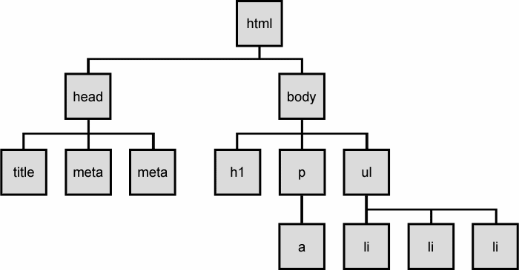
The DOM tree

Slide 76
Selecting groups of DOM objects
name | description
getElementById | returns array of descendents with the given tag, such as "div"
getElementsByTagName | returns array of descendents with the given tag, such as "div"
getElementsByName | returns array of descendents with the given name attribute (mostly useful for accessing form controls)
querySelector * | returns the first element that would be matched by the given CSS selector string
querySelectorAll * | returns an array of all elements that would be matched by the given CSS selector string

Slide 77
jQuery node identification
// id selector
var elem = $("#myid");
// group selector
var elems = $("#myid, p");
// context selector
var elems = $("#myid < div p");
// complex selector
var elems = $("#myid < h1.special:not(.classy)");

Slide 78
jQuery Selectors
http://api.jquery.com/category/selectors/

Slide 79
jQuery / DOM comparison
DOM method | jQuery equivalent
getElementById("id") | $("#id")
getElementsByTagName("tag") | $("tag")
getElementsByName("somename") | $("[name='somename']")
querySelector("selector") | $("selector")
querySelectorAll("selector") | $("selector")

Slide 80
Exercise
Use jQuery selectors to identify elements with these properties in a hypothetical page:
All p tags that have no children, but only if they don't have a class of ignore
Any element with the text "REPLACE_ME" in it.
All div tags with a child that has a class of special
All heading elements (h1, h2, h3, h4, h5, h6)
Every other visible li.
Use the DOM API to target the #square and periodically change it's position in a random direction.
Use jQuery selectors instead of the DOM API.

Slide 81
jQuery terminology
the jQuery function
refers to the global jQuery object or the $ function depending on the context
a jQuery object
the object returned by the jQuery function that often represents a group of elements
selected elements
the DOM elements that you have selected for, most likely by some CSS selector passed to the jQuery function and possibly later filtered further

Slide 82
The jQuery object
The $ function always (even for ID selectors) returns an array-like object called a jQuery object.
The jQuery object wraps the originally selected DOM objects.
You can access the actual DOM object by accessing the elements of the jQuery object.
// false
document.getElementById("id") == $("#myid");
document.querySelectorAll("p") == $("p");
// true
document.getElementById("id") == $("#myid")[0];
document.getElementById("id") == $("#myid").get(0);
document.querySelectorAll("p")[0] == $("p")[0];

Slide 83
Using $ as a wrapper
$ adds extra functionality to DOM elements
passing an existing DOM object to $ will give it the jQuery upgrade
// convert regular DOM objects to a jQuery object
var elem = document.getElementById("myelem");
elem = $(elem);
var elems = document.querySelectorAll(".special");
elems = $(elems);

Slide 84
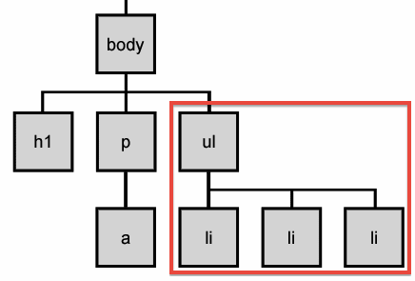
DOM context identification
You can use querySelectorAll() and querySelector() on any DOM object.
When you do this, it simply searches from that part of the DOM tree downward.
Programmatic equivalent of a CSS context selector
var list = document.getElementsByTagName("ul")[0];
var specials = list.querySelectorAll('li.special');

Slide 85
find / context parameter
jQuery gives two identical ways to do contextual element identification
var elem = $("#myid");
// These are identical
var specials = $("li.special", elem);
var specials = elem.find("li.special");

Slide 86
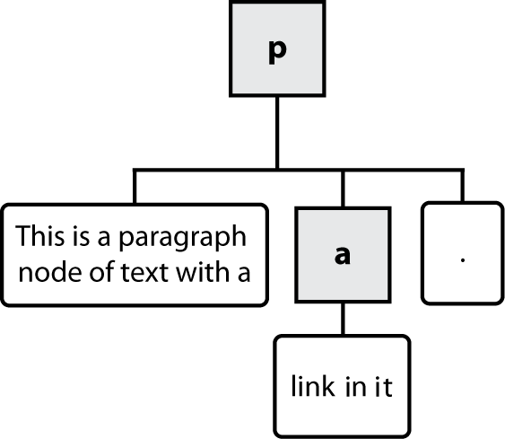
Types of DOM nodes
<p>
This is a paragraph of text with a
<a href="/path/page.html">link in it</a>.
</p>

Slide 87
Traversing the DOM tree
name(s) | description
firstChild, lastChild | start/end of this node's list of children
childNodes | array of all this node's children
nextSibling, previousSibling | neighboring nodes with the same parent
parentNode | the element that contains this node
complete list of DOM node properties
browser incompatiblity information (IE6 sucks)

Slide 88
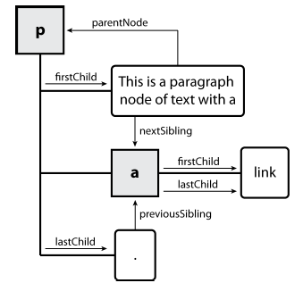
DOM tree traversal example
<p id="foo">This is a paragraph of text with a
<a href="/path/to/another/page.html">link</a>.</p> HTML

Slide 89
Elements vs text nodes
<div>
<p>
This is a paragraph of text with a
<a href="page.html">link</a>.
</p>
</div> HTML
Q: How many children does the div above have?
A: 3
an element node representing the <p>
two text nodes representing "\n\t" (before/after the paragraph)
Q: How many children does the paragraph have? The a tag?

Slide 90
jQuery traversal methods
http://api.jquery.com/category/traversing/

Slide 91
jQuery tutorials
Code Academy
http://www.codecademy.com/courses/you-and-jquery/0?curriculum_id=4fc3018f74258b0003001f0f#!/exercises/0
Code School:
http://www.codeschool.com/courses/jquery-air-first-flight

Slide 92
jQuery Example
jQuery is developed by Google. To create the first jQuery example, you need to use JavaScript file for jQuery. You can download the jQuery file from jquery.com or use the absolute URL of jQuery file.
In this jQuery example, we are using the absolute URL of jQuery file. The jQuery example is written inside the script tag.
Let's see a simple example of jQuery.

Slide 93
<!DOCTYPE html>
<html>
<head>
<title>First jQuery Example</title>
<script type="text/javascript" src="http://ajax.googleapis.com/ajax/libs/jquery/2.1.3/jquery.min.js">
</script>

Slide 94
<script type="text/javascript" language="javascript">
$(document).ready(function() {
$("p").css("background-color", "cyan");
});
</script>
</head>
<body>
<p>The first paragraph is selected.</p>
<p>The second paragraph is selected.</p>
<p>The third paragraph is selected.</p>
</body>
</html>

Slide 95
<!DOCTYPE html>
<html>
<head>
<title>Second jQuery Example</title>
<script type="text/javascript" src="http://ajax.googleapis.com/ajax/libs/jquery/2.1.3/jquery.min.js">
</script>

Slide 96
<script type="text/javascript" language="javascript">
$(function() {
$("p").css("color", "red");
});
</script>
</head>
<body>
<p>The first paragraph is selected.</p>
<p>The second paragraph is selected.</p>
<p>The third paragraph is selected.</p>
</body>
</html>

Slide 97
Angular JS
A brief Introduction
Adekunle

Slide 98
What is AngularJS
MVC Javascript Framework by Google for Rich Web Application Development

Slide 99
Why AngularJS
“Other frameworks deal with HTML’s shortcomings by either abstracting away HTML, CSS, and/or JavaScript or by providing an imperative way for manipulating the DOM. Neither of these address the root problem that HTML was not designed for dynamic views”.
Structure, Quality and Organization
Lightweight ( < 36KB compressed and minified)
Free
Separation of concern
Modularity
Extensibility & Maintainability
Reusable Components
“ HTML? Build UI Declaratively! CSS? Animations! JavaScript? Use it the plain old way!”

Slide 100
jQuery
Allows for DOM Manipulation
Does not provide structure to your code
Does not allow for two way binding

Slide 101
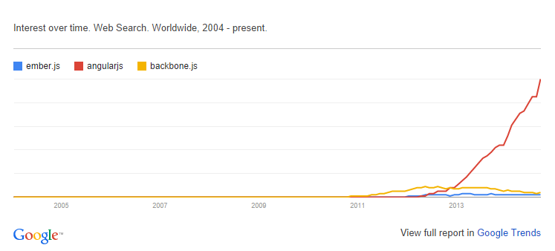
Other Javascript MV* Frameworks
BackboneJS
EmberJS

Slide 102
Features of AngularJS
Two-way Data Binding – Model as single source of truth
Directives – Extend HTML
MVC
Dependency Injection
Testing
Deep Linking (Map URL to route Definition)
Server-Side Communication

Slide 103
Data Binding
<html ng-app>
<head>
<script src='angular.js'></script>
</head>
<body>
<input ng-model='user.name'>
<div ng-show='user.name'>Hi {{user.name}}</div>
</body>
</html>

Slide 104
MVC
Model (Data)
View (UI)
Notifies
Notifies
Changes
Controller (Logic)

Slide 105
MVC
Model
JS Objects
View
DOM
Controller
JS Classes

Slide 106
MVC
<html ng-app>
<head>
<script src='angular.js'></script>
<script src='controllers.js'></script>
</head>
<body ng-controller='UserController'>
<div>Hi {{user.name}}</div>
</body>
</html>
function XXXX($scope) {
$scope.user = { name:'Larry' };
}

Slide 107
Hello HTML
<p>Hello World!</p>

Slide 108
Hello Javascript
<p id="greeting1"></p>
<script>
var isIE = document.attachEvent;
var addListener = isIE
? function(e, t, fn) {
e.attachEvent('on' + t, fn);}
: function(e, t, fn) {
e.addEventListener(t, fn, false);};
addListener(document, 'load', function(){
var greeting = document.getElementById('greeting1');
if (isIE) {
greeting.innerText = 'Hello World!';
} else {
greeting.textContent = 'Hello World!';
}
});
</script>

Slide 109
Hello JQuery
<p id="greeting2"></p>
<script>
$(function(){
$('#greeting2').text('Hello World!');
});
</script>

Slide 110
Hello AngularJS
<p ng:init="greeting = 'Hello World!'">{{greeting}}</p>

Slide 111
DEMONSTRATION!!!!!
Feeder App
http://www.toptal.com/angular-js/a-step-by-step-guide-to-your-first-angularjs-app

Slide 112
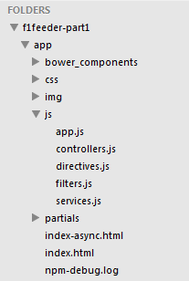
App Skeleton

Slide 113
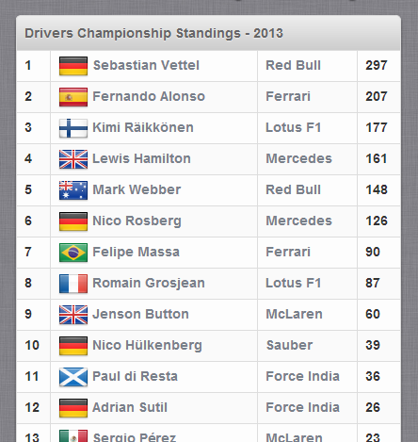
Final View (Championship Table)

Slide 114
Sample Angular Powered View
<body ng-app="F1FeederApp" ng-controller="driversController">
<table>
<thead>
<tr><th colspan="4">Drivers Championship Standings</th></tr>
</thead>
<tbody>
<tr ng-repeat="driver in driversList">
<td>{{$index + 1}}</td>
<td>
<img src="img/flags/{{driver.Driver.nationality}}.png" />
{{driver.Driver.givenName}}&nbsp;{{driver.Driver.familyName}}
</td>
<td>{{driver.Constructors[0].name}}</td>
<td>{{driver.points}}</td>
</tr>
</tbody>
</table>
</body>

Slide 115
Expressions
Expressions allow you to execute some computation in order to return a desired value.
{{ 1 + 1 }}
{{ 946757880 | date }}
{{ user.name }}
you shouldn’t use expressions to implement any higher-level logic.

Slide 116
Directives
Directives are markers (such as attributes, tags, and class names) that tell AngularJS to attach a given behaviour to a DOM element (or transform it, replace it, etc.)
Some angular directives
The ng-app - Bootstrapping your app and defining its scope.
The ng-controller - defines which controller will be in charge of your view.
The ng-repeat - Allows for looping through collections

Slide 117
Directives as Components
<rating max='5' model='stars.average'>
<tabs>
<tab title='Active tab' view='...'>
<tab title='Inactive tab' view='...'>
</tabs>
<tooltip content='messages.tip1'>

Slide 118
Adding Controllers
angular.module('F1FeederApp.controllers', []).
controller('driversController', function($scope) {
$scope.driversList = [
{
Driver: {
givenName: 'Sebastian',
familyName: 'Vettel'
},
points: 322,
nationality: "German",
Constructors: [
{name: "Red Bull"}
]
},
{
Driver: {
givenName: 'Fernando',
familyName: 'Alonso'
},
points: 207,
nationality: "Spanish",
Constructors: [
{name: "Ferrari"}
]
}
];
});
The $scope variable – Link your controllers and view

Slide 119
App.js
angular.module('F1FeederApp', [
'F1FeederApp.controllers'
]);
Initializes our app and register the modules on which it depends

Slide 120
Index.html
<body ng-app="F1FeederApp" ng-controller="driversController">
<table>
<thead>
<tr><th colspan="4">Drivers Championship Standings</th></tr>
</thead>
<tbody>
<tr ng-repeat="driver in driversList">
<td>{{$index + 1}}</td>
<td>
<img src="img/flags/{{driver.Driver.nationality}}.png" />
{{driver.Driver.givenName}}&nbsp;{{driver.Driver.familyName}}
</td>
<td>{{driver.Constructors[0].name}}</td>
<td>{{driver.points}}</td>
</tr>
</tbody>
</table>
<script src="bower_components/angular/angular.js"></script>
<script src="bower_components/angular-route/angular-route.js"></script>
<script src="js/app.js"></script>
<script src="js/services.js"></script>
<script src="js/controllers.js"></script>
</body>
</html>

Slide 121
Loading data from the server(services.js)
angular.module('F1FeederApp.services', []).
factory('ergastAPIservice', function($http) {
var ergastAPI = {};
ergastAPI.getDrivers = function() {
return $http({
method: 'JSONP',
url: 'http://ergast.com/api/f1/2013/driverStandings.json?callback=JSON_CALLBACK'
});
}
return ergastAPI;
});
$http - a layer on top of XMLHttpRequest or JSONP
$resource - provides a higher level of abstraction
Dependency Injection
we create a new module (F1FeederApp.services) and register a service within that module (ergastAPIservice).

Slide 122
Modified controller.js
angular.module('F1FeederApp.controllers', []).
controller('driversController', function($scope, ergastAPIservice) {
$scope.nameFilter = null;
$scope.driversList = [];
ergastAPIservice.getDrivers().success(function (response) {
//Dig into the responde to get the relevant data
$scope.driversList = response.MRData.StandingsTable.StandingsLists[0].DriverStandings;
});
});

Slide 123
Routes
$routeProvider – used for dealing with routes
Modified app.js
angular.module('F1FeederApp', [
'F1FeederApp.services',
'F1FeederApp.controllers',
'ngRoute'
]).
config(['$routeProvider', function($routeProvider) {
$routeProvider.
when("/drivers", {templateUrl: "partials/drivers.html", controller: "driversController"}).
when("/drivers/:id", {templateUrl: "partials/driver.html", controller: "driverController"}).
otherwise({redirectTo: '/drivers'});
}]);

Slide 124
Partial views
<!DOCTYPE html>
<html>
<head>
<title>F-1 Feeder</title>
</head>
<body ng-app="F1FeederApp">
<ng-view></ng-view>
<script src="bower_components/angular/angular.js"></script>
<script src="bower_components/angular-route/angular-route.js"></script>
<script src="js/app.js"></script>
<script src="js/services.js"></script>
<script src="js/controllers.js"></script>
</body>
</html>

Slide 125
Advanced AngularJS Concept
Dependency Injection
Modularity
Digesting
Scope
Handling SEO
End to End Testing
Promises
Localization
Filters

Slide 126
Useful Links
https://angularjs.org/
http://campus.codeschool.com/courses/shaping-up-with-angular-js/contents
http://www.toptal.com/angular-js/a-step-by-step-guide-to-your-first-angularjs-app
https://github.com/raonibr/f1feeder-part1

